Slide 1

Crime in Los Angeles
By Silvia Rosario Betances, Hana Sijad, Faith Wade & Vanessa Saum

Slide 2

Dataset Used
Crimes in Los Angeles (Link)
Variables Included: Reported Incidents, Time Incidents Happened & Recorded, Patterns & Trends, Demographic & Geographical Analysis.
Last Updated on March 8th, 2026 (Relevant Source)

Slide 3

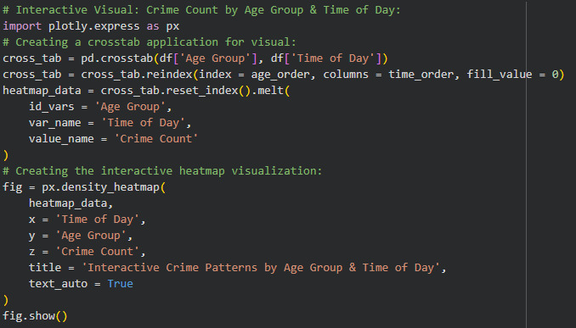
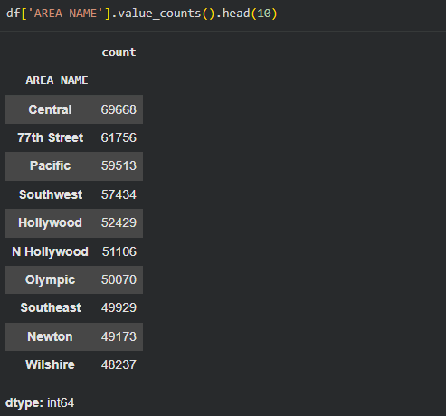
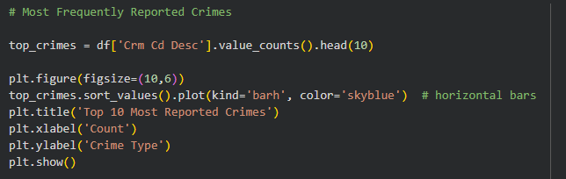
Actions Performed
Data Wrangling: Silvia Rosario Betances
Data Scientist: Hana Sijad
Data Visualizer(s): Vanessa Saum & Faith Wade

Slide 4
Main Goals
Primary Question:
How does the crime patterns across victim age groups & the time of day?
Secondary Questions:
What types of crimes are most frequently reported?
At what times of day do most crimes occur?
Are certain geographic areas more prone to crime?
Has crime increased or decreased over the years?
What victim demographics are most associated with crime incidents?

Slide 5
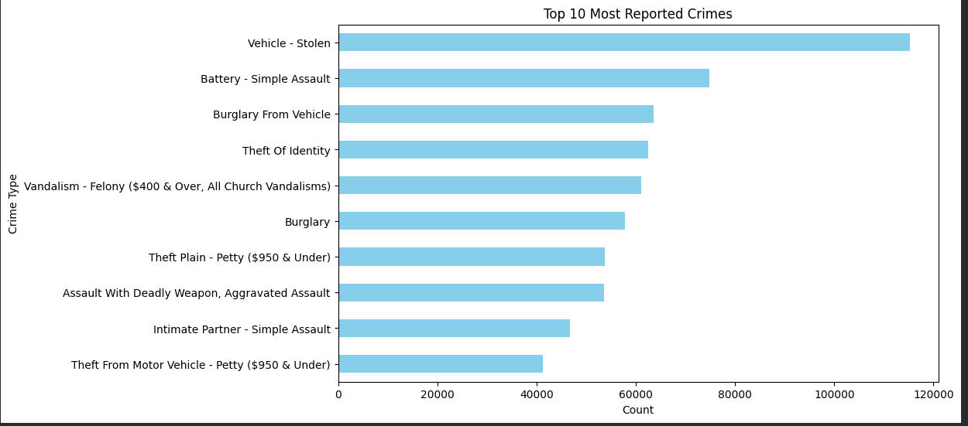
Times Most Frequently Reported
Most frequently reported: Stolen Vehicles
Almost 120,000 crimes reported in related theft.
Runner Ups: Battery Assault & Burglary (Crimes could have a connection with one another.)

Slide 6
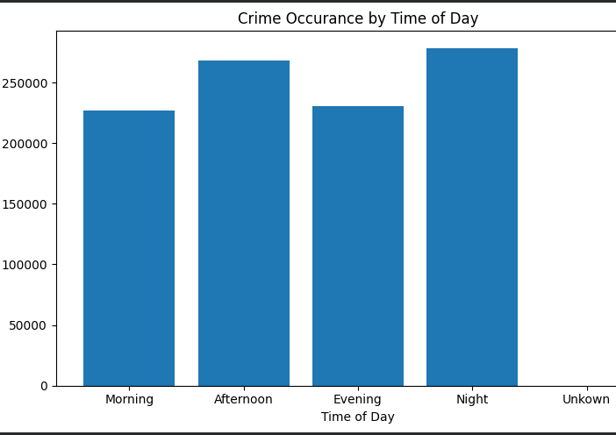
Times of Day Crimes Occur
Most Frequent Crime Occurrence: Night
Over 250,000 Crimes Reported
Runner Ups: Afternoon & Evening (Could indicate a hint to certain locations within LA.)

Slide 7
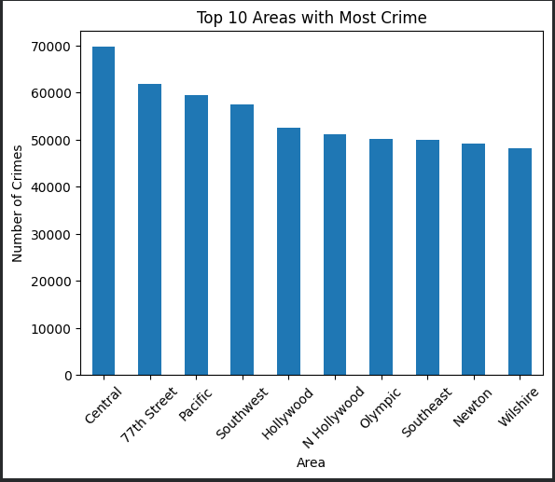
Geographic Areas of Crime
Most Frequent Geographic Location of Crime: Central
Calculated 69,668 crimes reported.
Runner Ups: 77th Street & Pacific (Gives an idea of potential crime hideaways located in between the locations.)

Slide 8
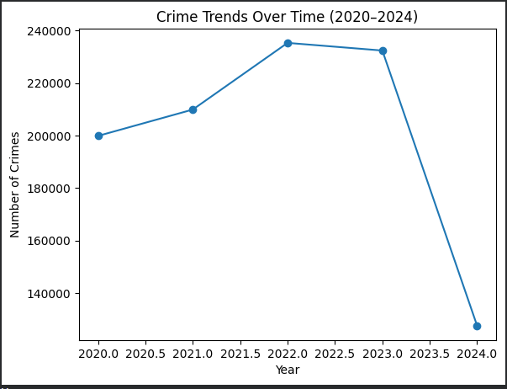
Trending Crimes Increasing or Decreasing?
Crime has overall shown a significant decrease in LA.
Between 2023 & 2024, there is a rounded 105,000 difference of the number of crimes per year.
Perhaps an influx in security or new procedures/events caused the drastic change.

Slide 9
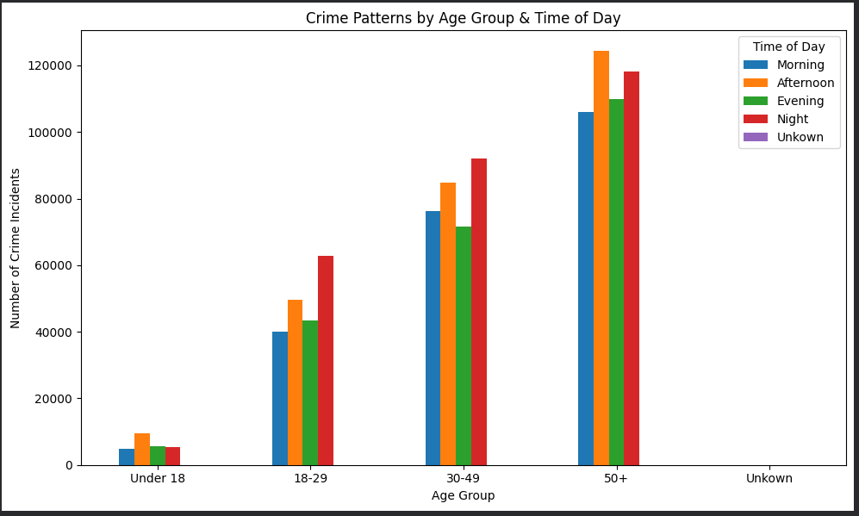

Victim Demographics in Relation to Crimes
Main Related Victim Demographics in Relation to Crimes Includes: Age & Gender.
Overall, 403,842 males, 358,553 females, and 242,499 anonymous individuals have been reported in crime-like instances.
The main age group for crime in LA appears to be around 50 and/or older.

Slide 10
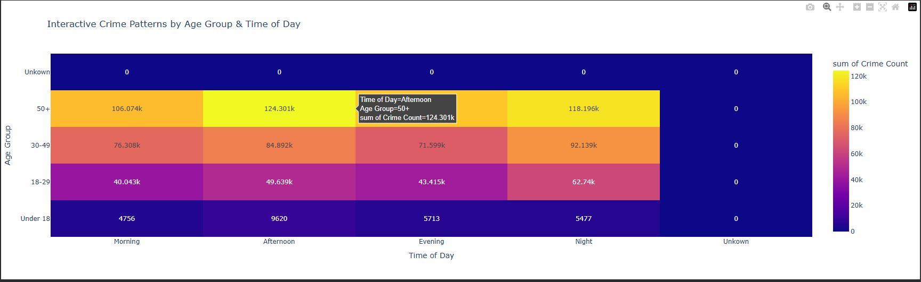
How does the crime patterns across victim age groups & the time of day?
Overall Answer: Adults around and/or over the age of 50 in the afternoon tend to commit the most crime.
Factors in Play: Frequency, Time, Geographic Location, Trends & Victim Demographics.

Slide 11
Conclusion
Analyses show the essential patterns & trends between each of the factors in an effective manner.
Addresses the main problems & provides a brief observation/solution for each.
Gives a wide variety for future research & development.

Slide 12

End

